Slide 1
INITIAL CONDITIONS

Slide 2
Initial conditions
SR_R1_offset
initial_F_parms
recdev
Fit to catch

Slide 3
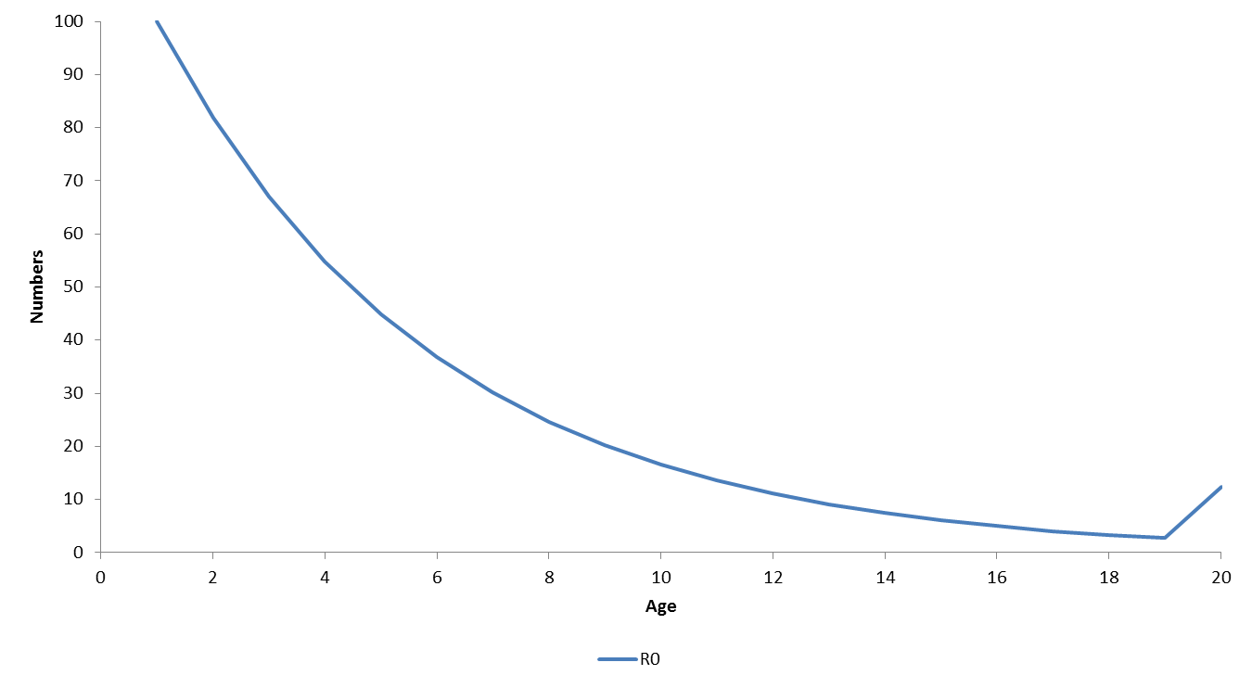
Initial conditions: virgin equilibrium

Slide 4
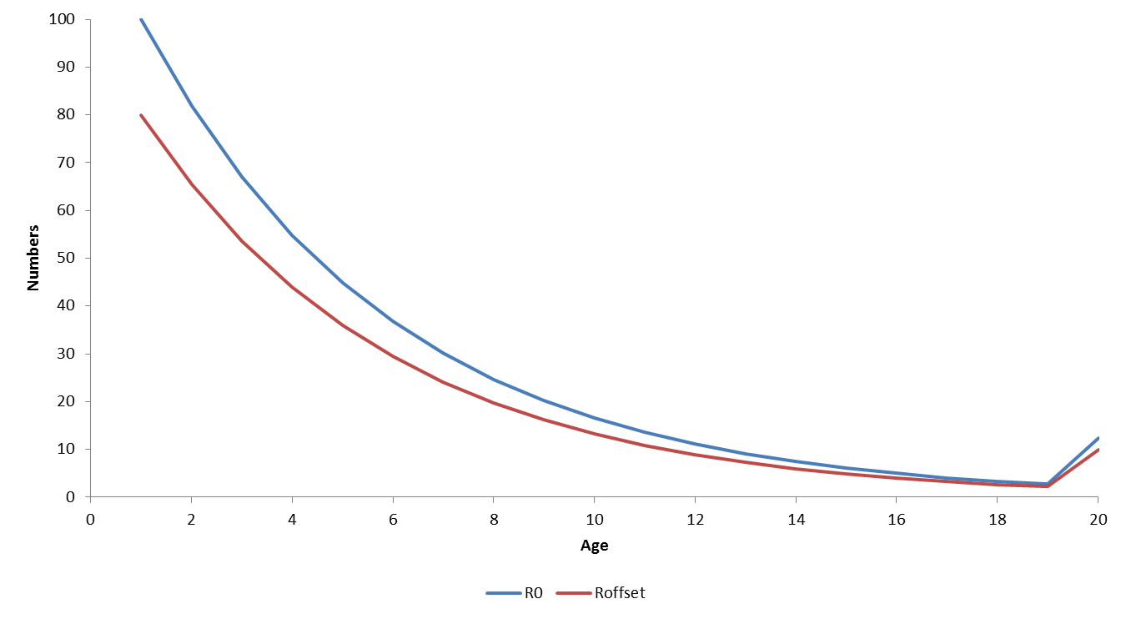
Initial conditions: recruitment offset

Slide 5
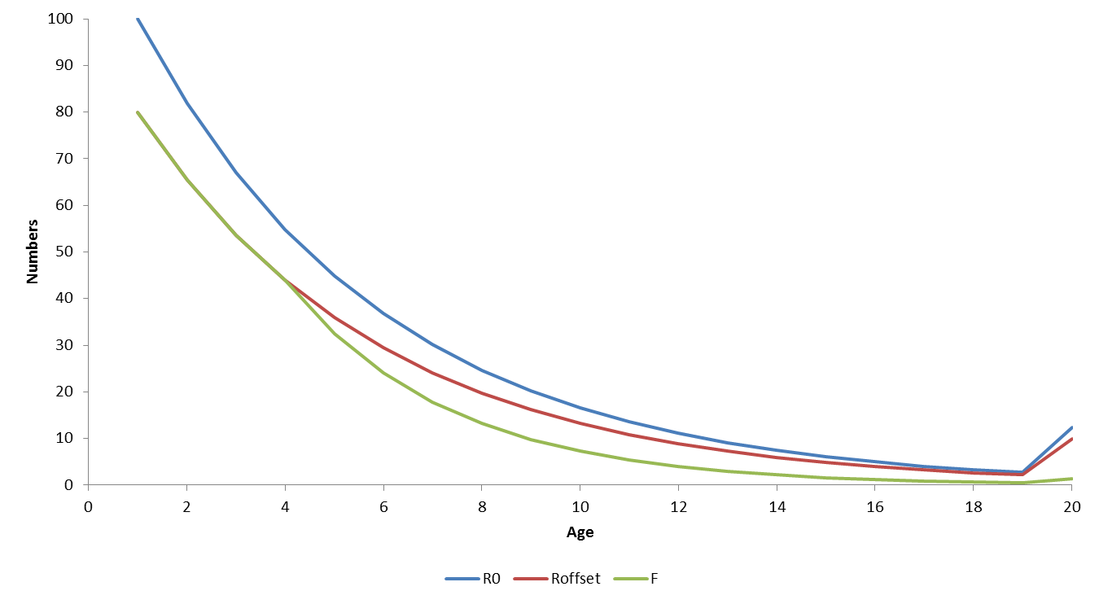
Initial conditions: fishing mortality

Slide 6
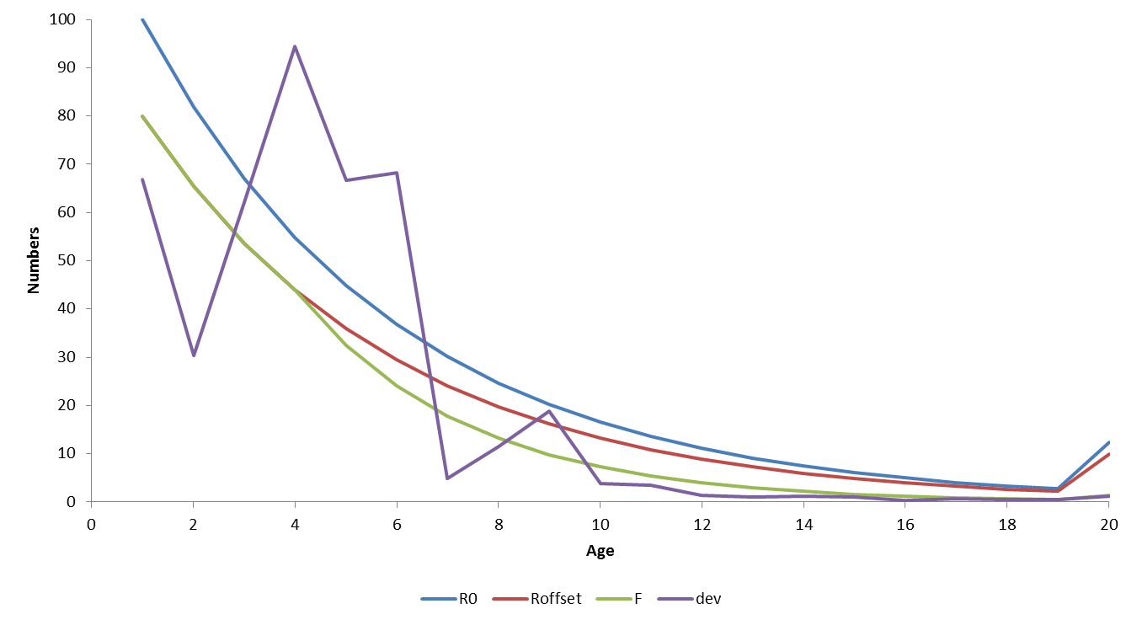
Initial conditions: deviates

